Slide 1
COMP28112
The Integration Game
Lecture 17
(material put together by Dean Kuo, some time ago!)
Notes:
COMP28112 Lecture 16

Slide 2
“One view holds that computer science is simply the art of realising successive layers of abstraction!”
Building large-scale distributed systems requires us to strike a balance between:
Performance
Reliability
User Requirements
Other constraints (eg, money…)
As well as software aspects:
http://static.googleusercontent.com/media/research.google.com/en//people/jeff/stanford-295-talk.pdf

Slide 3
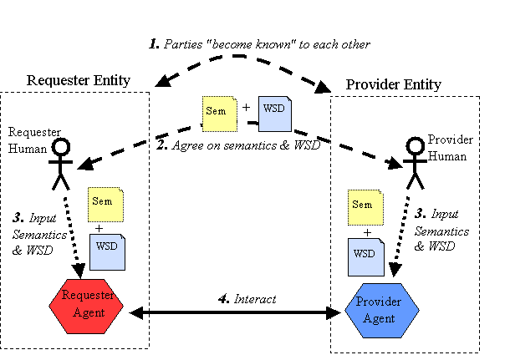
Service is the idea that links requestor and provider
Semantic descriptions are needed to ensure that the requestor gets the “right” service.
Notes:
COMP28112 Lecture 16

Slide 4

Service Oriented Architecture (SOA)
Principles for building systems meeting the requirements:
  Reliable, fault-tolerant, responsive, scalable and secure
  Interoperate across computing platforms and administrative domains
Notes:
COMP28112 Lecture 16

Slide 5

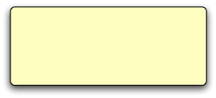

Service
A service is a collection of code and data that stands alone
The ONLY way in and out of a service is via messages
Services are durable and survive crashes
Notes:
COMP28112 Lecture 16

Slide 6
What follows are known as the four tenets of SOA
Service boundaries are explicit
Services are autonomous
Services share Schema and Contracts
Service Compatibility is based on policy
Notes:
COMP28112 Lecture 16

Slide 7
Service Boundaries are Explicit
No ambiguity as to where a piece of code and data resides
It is explicit if a piece of code is inside or outside a service
  E.g. Internet banking - the code and data live inside the banking service
Services are Autonomous
Services are developed and managed independently
A service can be re-written without impacting other services
  With some constraints
Notes:
COMP28112 Lecture 16

Slide 8
Services Share Schema and Contracts
Schema defines the messages a service can send and receive
Contract defines permissible message sequences
Services do not share implementations
  Independent of computing platform or languages
Service Compatibility is Based on Policy
Defines the rules for using a service
  E.g. security policy specifies who can use the service
  Introduces the idea of roles into distributed computing
  Question of whether services are organised into an overall Virtual Organisation or are accessed over an open network or market.
Notes:
COMP28112 Lecture 16

Slide 9
More Complex Services
Purchase of goods or resource
  Get a quote, make a reservation, make changes, make payment, cancel ticket
  Book 100 hours and 500 Gbytes of storage on a computing cloud
    All these messages are related to a particular order
  Need an unique identifier to correlate the messages
Notes:
COMP28112 Lecture 16

Slide 10
Service Schema
Defines the message schema for
  Quote request
  Quote
  Purchase order
  Invoice
  ...
Notes:
COMP28112 Lecture 16

Slide 11

Service Contract
Defines the causal relationship between the messages - e.g.
  Quote request before quote
  Specifies if quote is optional or mandatory
Co-relation identifier to link the messages in a conversation
Send QuoteReq
Rec Quote
Send PO
Rec PO Ack
Notes:
COMP28112 Lecture 16

Slide 12
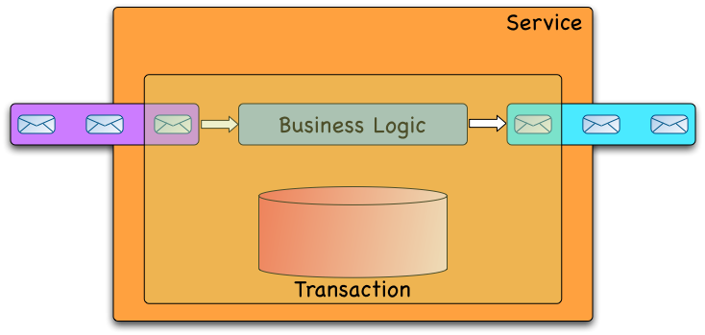
Putting It All Together
Notes:
COMP28112 Lecture 16

Slide 13
Transactions Inside a Service
Begin_Transaction
  Get message from the in queue
  Process message
  Put message on the out queue
Commit
Crash
Crash
Crash
Crash
Transactions Across Queuing system and Database
Two-phase commit between the queuing system and the database
Notes:
COMP28112 Lecture 16

Slide 14
Services Share Schema
Incoming message
  Service transforms the message from the “shared schema” to its internal schema
Outgoing message
  Service transforms from its internal schema to the “shared schema”
Notes:
COMP28112 Lecture 16
May loose some information in the translation

Slide 15
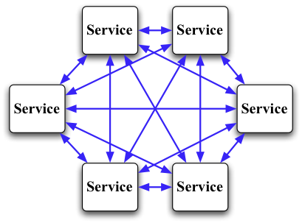
Shared Schema Between Every Pair of Services
N x (N-1) number of transformations
12 services => 132 transformations
Notes:
COMP28112 Lecture 16

Slide 16
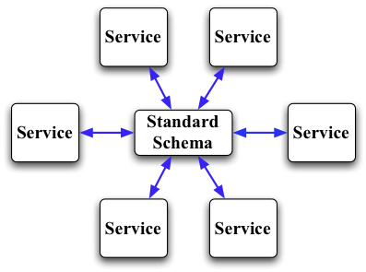
The Need for Standards
2N number of transformations
12 services => 24 transformations
Notes:
COMP28112 Lecture 16

Slide 17
Which one is simpler?
Not a scalable Solution
Notes:
COMP28112 Lecture 16

Slide 18
Schema Mapping Problems
There are difficulties in mapping a service’s internal schema to another schema
Unfortunately, it can be very difficult and at times impossible to achieve
Notes:
COMP28112 Lecture 16

Slide 19
Name Conflicts
Same concept but different names
Same name but different concepts
  One price includes VAT and the other does not
<slot_id> 3 </slot_id>
<price> 45.10 </price>
<slot> 3 </slot>
<price> 53 </price>
Notes:
COMP28112 Lecture 16

Slide 20


Structural Mismatches
Structure of the information is different
<address>
303 Deansgate Manchester M3 4LQ United Kingdom
</address>
<address>
<street> 303 Deansgate </street>
<city> Manchester </city>
<postcode> M3 4LQ </postcode>
<country> United Kingdom </country>
</address>
Notes:
COMP28112 Lecture 16

Slide 21
Different Representation
Student Marks
(0 - 100)
Student Marks
HD (90 - 100)
D (75 - 89)
C (65 - 74)
P (50 - 64)
F (0 - 49)
Student Marks
HD (85 - 100)
D (70 - 84)
C (60 - 69)
P (45 - 59)
F (0 - 44)
Notes:
COMP28112 Lecture 16
Precision, default values, ...

Slide 22
Ontologies and semantics
If we can say what the information “means” we can have some hope of reconciling different syntax for the “same” thing.
This is known as a semantic description of the data.
Ontologies are tools used to capture the “meaning” of data or services.
An ontology is the representation of a set of concepts within a domain and it allows reasoning about those concepts, e.g. to assert equivalence.
Notes:
COMP28112 Lecture 16

Slide 23
Agreement on a standard is HARD!
But often not for technological reasons
Each service, for economical reasons, will want to reduce the costs of writing code to transform their data to and from the standard
Sometimes it is extremely hard or impossible to transform the data
Standards will evolve slowly:
  Driven by large organisations such as TESCO, ... or
  Mandated by government or
  By a community
Slow, painful and expensive process
Notes:
COMP28112 Lecture 16

Slide 24
Message-Oriented Middleware (MOM)
Plumbing for shipping messages between the services
  SOA is all about using messages to connect services
Asynchronous and non-blocking message passing
  Sender application sends and does not wait for a response - similar to sending emails
  Recipient may or may not be actively processing incoming messages when the message is sent
Notes:
COMP28112 Lecture 16

Slide 25
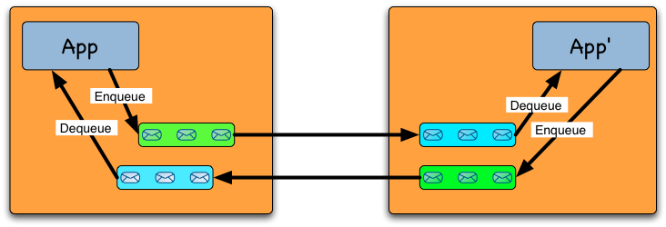
Point-to-Point messaging
Sender specifies a recipient
  Message is delivered to ONE recipient
Notes:
COMP28112 Lecture 16

Slide 26
MOM supports Three Types of Delivery Modes
At most once
At least once
Exactly once
Notes:
COMP28112 Lecture 16

Slide 27
At Most Once
(Best Effort)
MOM sends and forgets
Most appropriate when it is not essential that the message is delivered
  E.g. live cricket and football scores, stock prices, ...
MOM does not need to write to stable storage
  Message may be lost due to failures
Notes:
COMP28112 Lecture 16

Slide 28
At Least Once
Sender sends a message
  Recipient will “eventually” receive at least one copy of the message
    Survives network and service failures
Used when a message must be received and application receiving the message can cope with duplicates
Notes:
COMP28112 Lecture 16

Slide 29
At Least Once
If the recipient does not acknowledge within a time-out, sender resends the message
  Repeat until sender receives an acknowledgment
    Safe to resend
    Safe for recipient to deliver a duplicate to the application
  Require the sender and receiver to write to stable storage to survive crashes
Notes:
COMP28112 Lecture 16

Slide 30
Application Processing a Message
At least once delivery - duplicates can be received
  Determine if this message is a duplicate
    If not then process the message; otherwise ignore the message
  Don’t need to worry about duplicates if it is a “read” request
    e.g. get bank balance
Duplicates will not cause inconsistencies
Notes:
COMP28112 Lecture 16

Slide 31
Exactly Once
Recipient is guaranteed that it will “eventually” receive exactly one copy of the message
Application processing the message “knows” that it has never processed this message before and a duplicate will never be delivered
  Makes it easier to write the application
Notes:
COMP28112 Lecture 16

Slide 32
Exactly once
Uses a variant of 2PC to ensure exactly once delivery
Requires the sender and receiver to write to stable storage
Message must be received and recipient can’t cope with duplicates
Sender
Receiver
Notes:
COMP28112 Lecture 16

Slide 33
In-Order Delivery
Messages are delivered to the receiving application in the same order as they were sent by the sending application
Notes:
COMP28112 Lecture 16

Slide 34
Throughput
From greatest to least
  At most once
  At least once
  Exactly once
Notes:
COMP28112 Lecture 16

Slide 35
Publish Subscribe
Sender publishes (sends) a message on a topic rather than a destination
  Subscriber subscribe to topics
  Similar to the idea of mailing lists
Notes:
COMP28112 Lecture 16

Slide 36
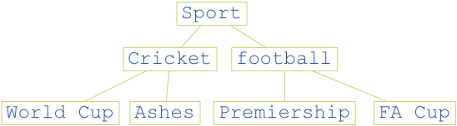
Topics
Topics are organised in a hierarchy
  Subscriber will receive all messages published on the subscribed topic and its sub-topics
Notes:
COMP28112 Lecture 16

Slide 37
Delivery Modes
Identical to point to point
  At most once
  At least once
  Exactly once
  In-order delivery
Notes:
COMP28112 Lecture 16

Slide 38
Messaging Technologies
IBM WebSphere MQ (formerly MQSeries)
MSMQ
SQLServer
  Native support for queues
ActiveMQ (open source)
TIBCO Rendevouz
...
Notes:
COMP28112 Lecture 16

Slide 39
The Need for Interoperability
Services must be able to exchange messages
  Remember, services do not share implementation
  Services should be free to choose the MOM of their choice
Notes:
COMP28112 Lecture 16

Slide 40
Unfortunately
MOMs from different vendors don’t interoperate
All applications must use THE SAME MOM implementation
  Violates service autonomy
Notes:
COMP28112 Lecture 16

Slide 41
Emerging Standards
Web Services Reliable Messaging (WS-Reliable Messaging)
Advanced Message Queuing Protocol (AMQP) - a message queuing protocol by JP Morgan Chase & Co, Red Hat, ...
Notes:
COMP28112 Lecture 16

Slide 42
SOA/Messaging
It WORKS and has worked for many centuries
  Initially, paper based systems
  Architecture for EAI (enterprise application integration) and B2B (business to business) integration
    Towards the paperless world
  Follows the KISS principle
    Keep It Simple Stupid
Notes:
COMP28112 Lecture 16

Slide 43
Summary I
Service-oriented architectures
  Simple set of design principles for building applications that is technology independent
  The use of messages to connect services
  A service is a collection of code and data and the only way in and out of a service is through “messages”
Four tenets of SOA
  Boundaries are explicit
  Services are autonomous
  Services share schema and contracts and not implementation
  Service compatibility is based on policy
Notes:
COMP28112 Lecture 16

Slide 44
Summary II
Message-Oriented Middleware
  Provides the infrastructure for SOA
  Semantic descriptions, can promote service discovery, matching and interoperability.
Messaging
  At most once, at least once and exactly once delivery
  Point-to-point and publish/subscribe
Transactions across queuing system and database
The need for standard schemas and MOM interoperability
Notes:
COMP28112 Lecture 16

Slide 45
Engineering Internet Scale Distributed Systems
Notes:
COMP28112 Lecture 16

Slide 46
Requirements
High availability
Responsive
Scalable
Reliable and fault-tolerant
Maintains data consistency in the presence of failures and concurrency
Notes:
COMP28112 Lecture 16
Scalable - Handle growing amounts of work in a graceful manner, or to be readily enlarged.

Slide 47
How should these systems be designed?
Notes:
COMP28112 Lecture 16

Slide 48
Architectural Styles
Define guiding principles for engineering systems
Technology independent
SOA is an architectural style based on messaging, idempotent operations, immutable messages, ...
Are there others for building Internet-scale distributed systems?
Can we learn from systems that work?
Notes:
COMP28112 Lecture 16

Slide 49
The Web
Has many of the key characteristics that we want
  High availability, scalable, responsive, ...
What can we learn from the success of the Web in building distributed systems?
What is the architectural style behind the Web?
  Focus of the rest of this lecture is the study of the architectural style behind the Web
Notes:
COMP28112 Lecture 16

Slide 50
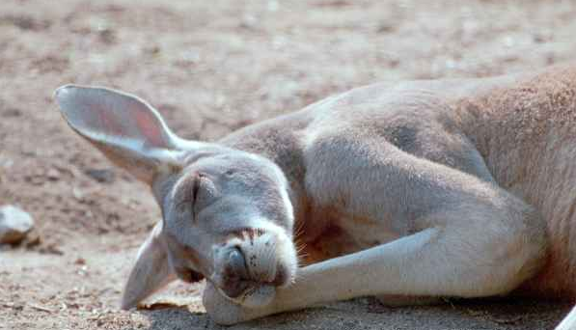
The architectural style behind the Web is REST - REpresentational State Transfer
Notes:
COMP28112 Lecture 16

Slide 51
REST
Term coined by Roy Fielding in his PhD thesis to describe an architectural style for networked (distributed) systems
  Course web site provide links to his thesis and other REST material
  REST is described in Chapter 5 of the thesis
Notes:
COMP28112 Lecture 16

Slide 52
Why is it called REST?
Key abstraction in REST is “resources”
  A resource can be anything that can be named
    COMP28112 course is a resource, everyone in the lecture is a resource ...
A resource can have a number of representations
  The HTML page at https://studentnet.cs.manchester.ac.uk/ugt/COMP28112/ is a HTML representation of this course
  A resource can have links to other resources
Notes:
COMP28112 Lecture 16

Slide 53
REST
Provides the image of a network of linked representation of resources
  Each “representation” provides information about the “state” of the resource
Client navigate through the resources via links
  Each link “transfers” the client to the representation (state) of another resource
So we have “REpresentational State Transfer” - REST
Notes:
COMP28112 Lecture 16

Slide 54
Implementation of REST
The idea is to make use of the existing technology, URL,XML,HTTP,SMTP etc. to build Web services.
For example HTTP supports these “verbs”:
  HEAD (get the Meta data about the resource)
  POST (create a resource)
  GET (get the state of the resource)
  PUT (modify the state of the resource)
  DELETE (destroy the resource)
Notes:
COMP28112 Lecture 16

Slide 55
REST
REST is independent of any middleware
  J2EE, .NET, CORBA, Web Services....
HTTP follows many of the principles prescribed by REST:
  URLs identify resources
    E.g. http://www.manchester.ac.uk identifies the resource “University of Manchester” while https://studentnet.cs.manchester.ac.uk/ugt/COMP28112/ identifies this course
    Opaque and exposes no details of the implementation
  Only representations are exposed
Notes:
COMP28112 Lecture 16

Slide 56
Representations of Resources
A resource can have multiple representations
  e.g. HTML, XML, JPEG, ...
Client specifies in the http “accept” header the representation it wants to receive
  HTML, XML, JPEG, ...
Notes:
COMP28112 Lecture 16

Slide 57
Uniform Interface
Resources have the same interface
  Simplifies the overall architecture
in HTTP, every resource has the same methods
  GET - retrieves a representation
  POST - creates a new resource
  PUT - updates an existing resource
  DELETE - deletes a resource
Notes:
COMP28112 Lecture 16

Slide 58
Stateless Interactions
Each request contains all the information necessary for the server to understand the request independent of any request that has preceded it
No context is stored on the server
  Should avoid the use of cookies
Benefits of statelessness:
Reliability
  Easy to manage server failures
Scalability
  Easy to add a new server to process messages
Notes:
COMP28112 Lecture 16

Slide 59
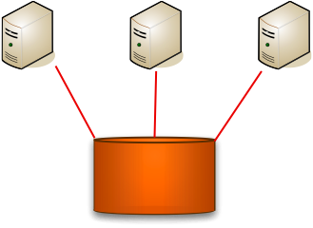
Resources
State of resources are stored in databases shared by the servers
Databases are good at storing data
  Reliable, fast, fault-tolerant, manage concurrency, ....
Notes:
COMP28112 Lecture 16

Slide 60
Summary
REST is an architectural style
  Defines a set of constraints for building internet scale distributed applications
Key abstraction is “resource”
Key constraints
  Anything that can be named can be a resource, URLs identify resources and uniform interface
Simple and elegant
Notes:
COMP28112 Lecture 16

